Slide 1
Regional Product Analysis
A visualization guide to understand product sales performance from historic data.

Slide 2
Summary
Here we are using the superstore dataset in tableau, to uncover the insights on products performance across various regions , to understand how are profits have impacted over course of years.
The hidden insights would contribute in planning and strategizing future business plans and goals.
The graphs here are plotted in tableau and for the purpose of simplicity, inserted in a powerpoint

Slide 3

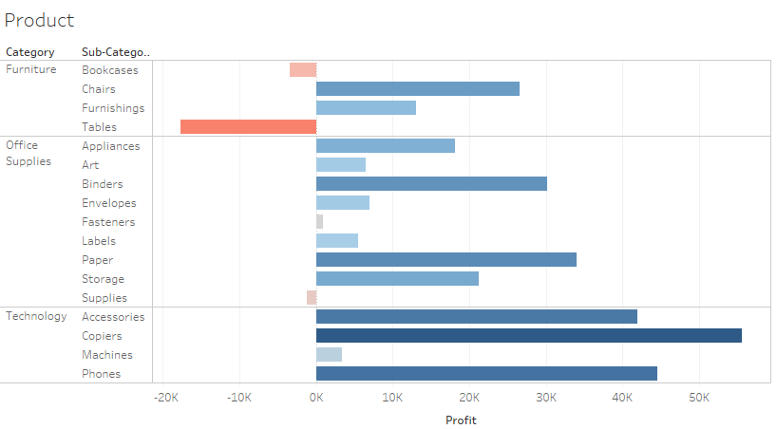
The graph displays profit by every product over time
In furniture tables have incurred the highest loss.
While Copiers in technology have earned highest profits over time
Most of the profit is comes from Technology based products
Notes:
The graph displays profit over time by different products.
Not every product was able to perform well .
The red colour here denotes the loss incurred by the products
Here we tried to analysed the profit and loss made by all products in our data store

Slide 4
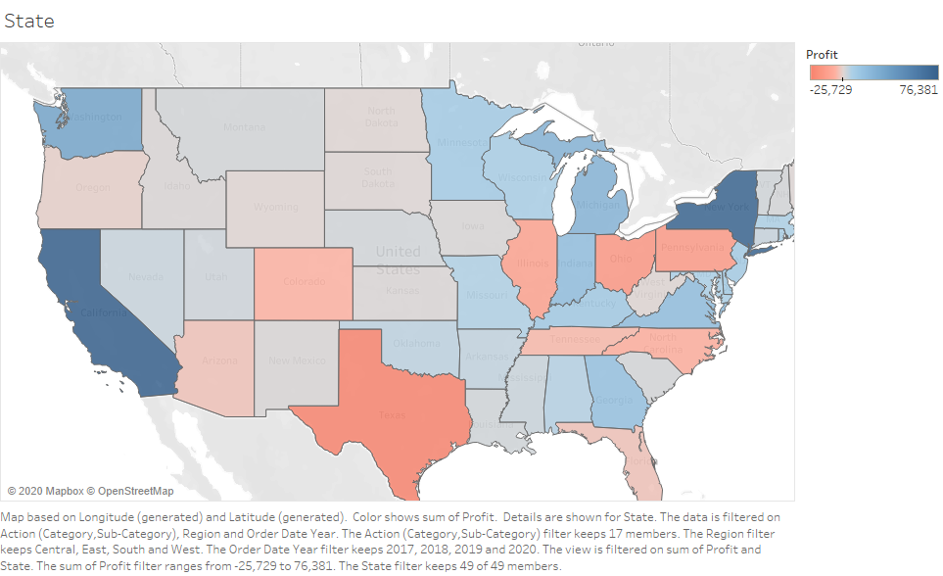
The eastern and the western regions are making more profits compared to central regions.
California is driving most of our profit in sales
This shows that California is our biggest consumer market to date .
Texas has incurred loss , understanding factors behind it improving them is a scope for future growth.
Notes:
Based on the learning from previous graph , we wanted to dig deeper and understand how was the profits distributed among regions.

Slide 5
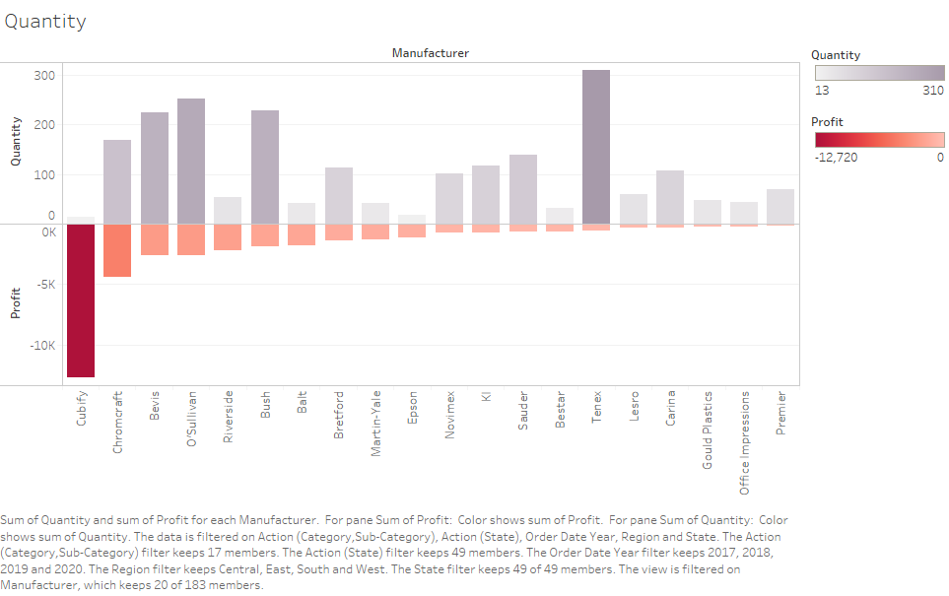
The graph shows us the manufactures , that have incurred losses over years .
It is interesting to see how the quantity of product sold is affecting the loss they incurred.
With the lowest product sold having the highest loss
However as sales increase , the loss reduces for that manufacture.

Slide 6
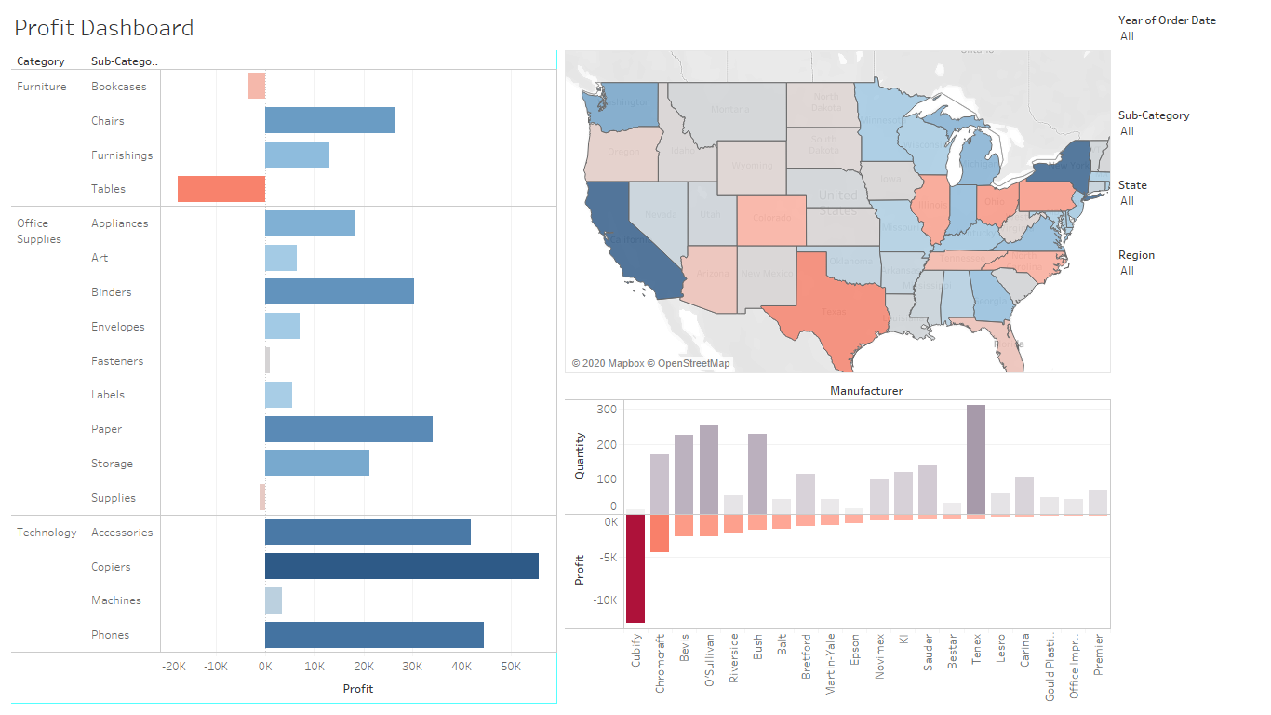
The above dashboard is displaying the profit of products for a company, how their sales profits are distributed across various regions ,and manufactures who haven’t had a beneficial sales years previously.

